Slide 1
Sha’s ppt
Project Final Presentation

Slide 2
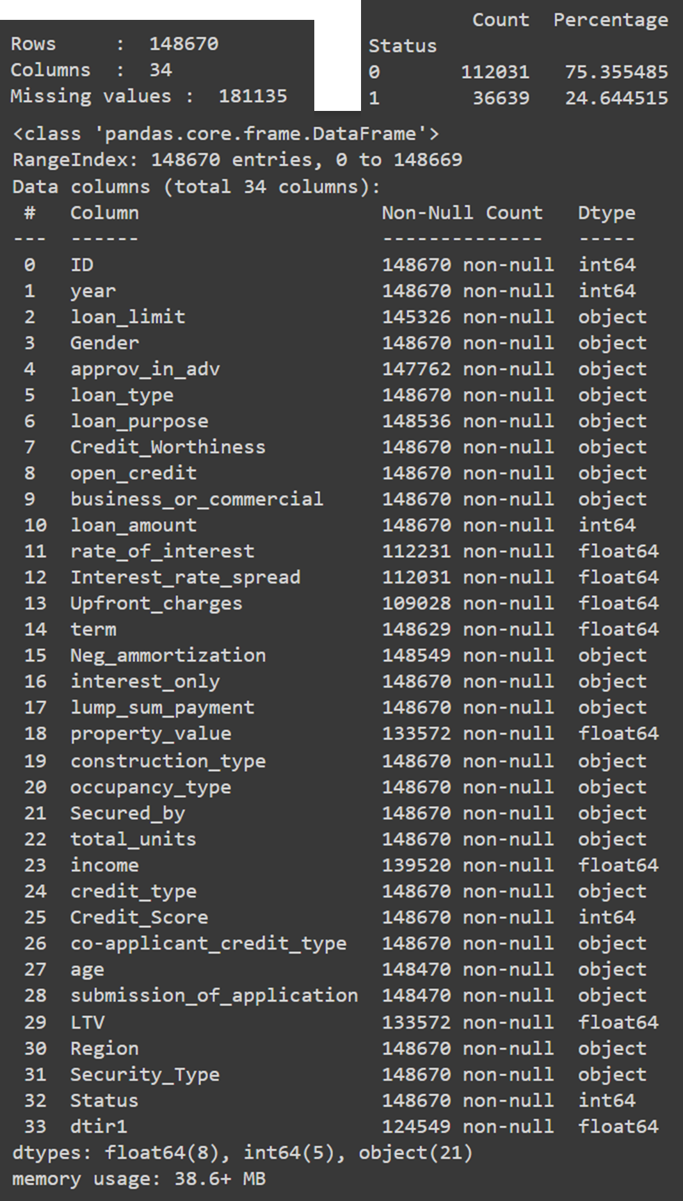
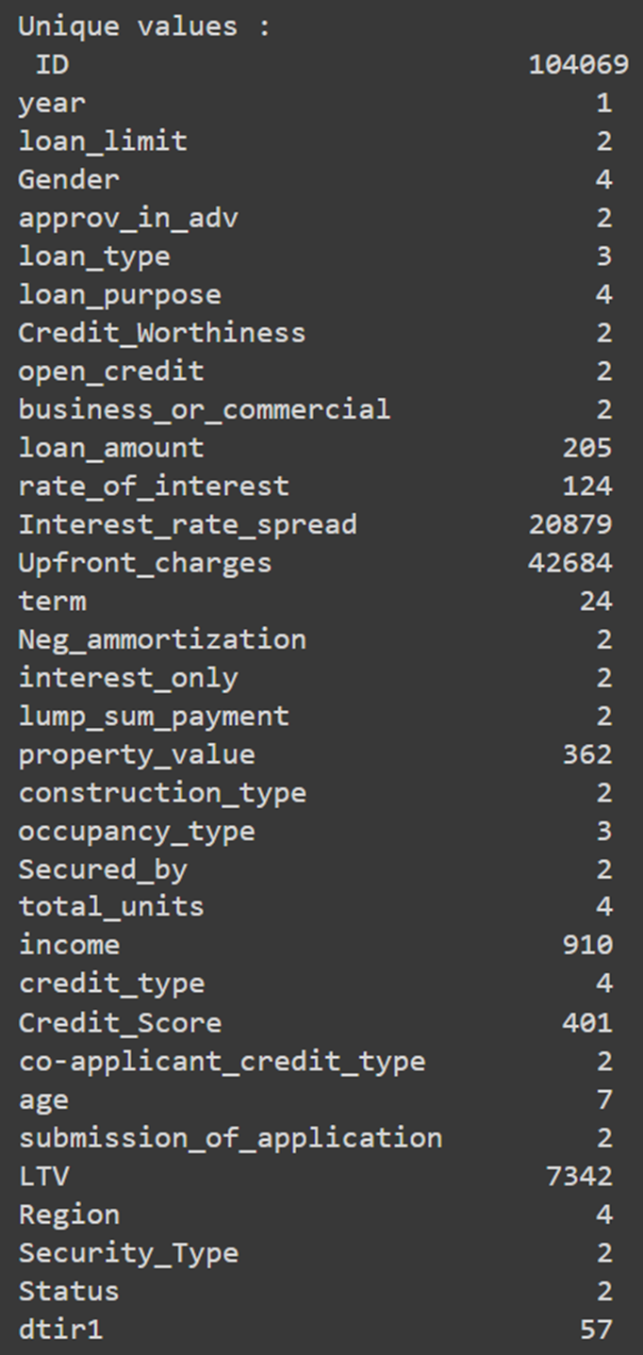
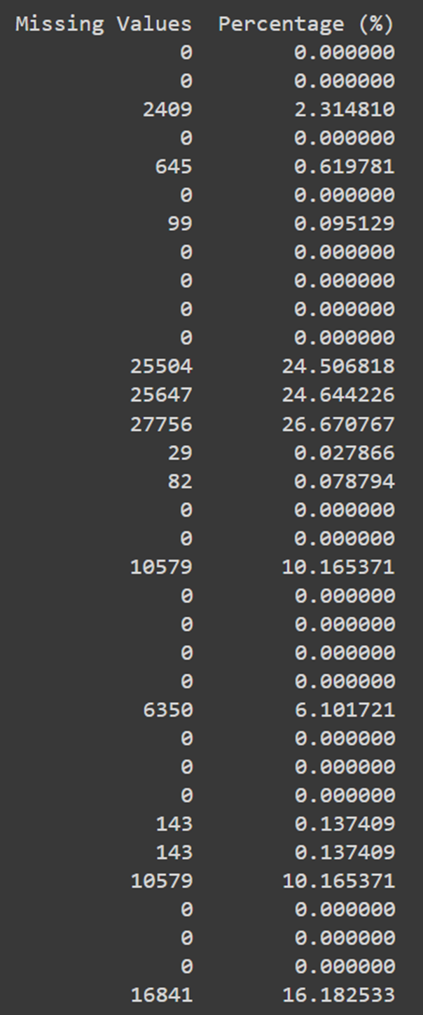
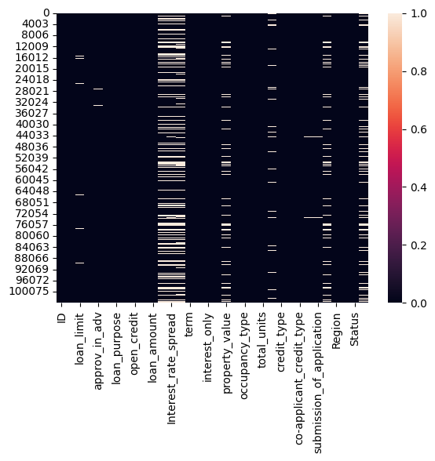
Initial Review of Loan Default dataset
Supervised binary classification problem.

Slide 3
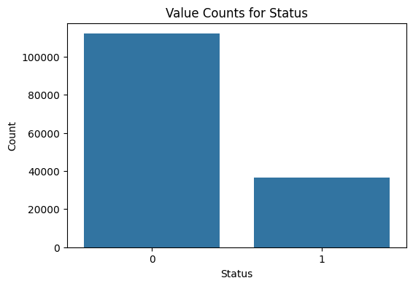
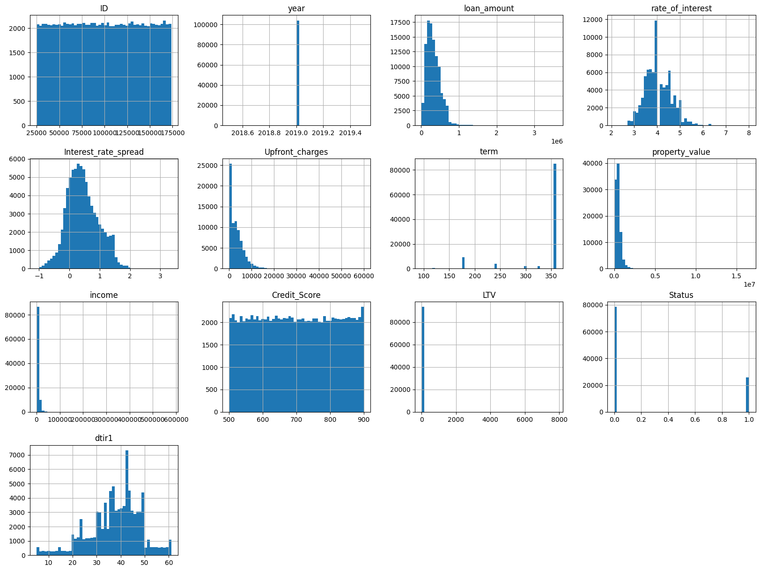
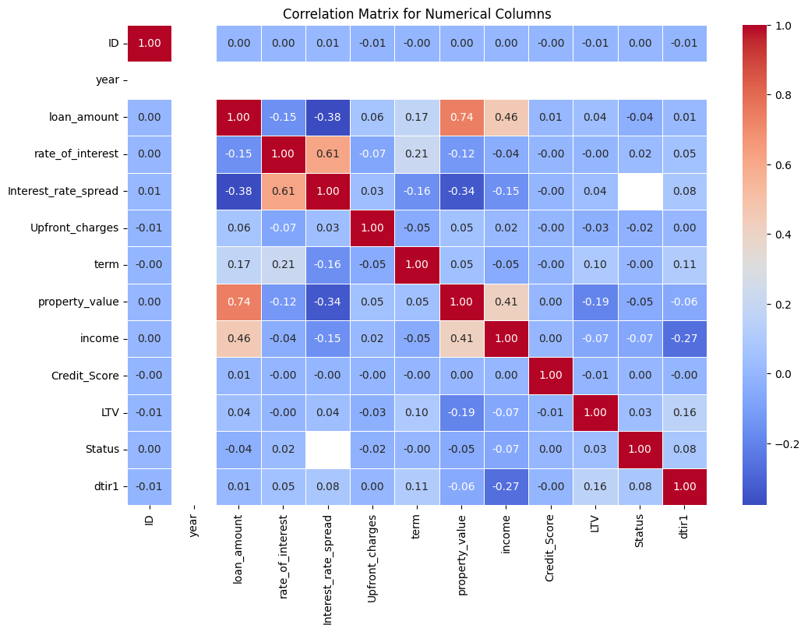
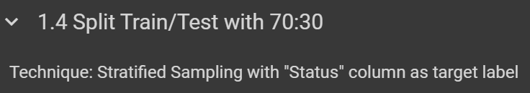
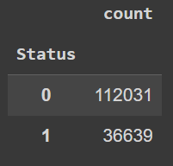
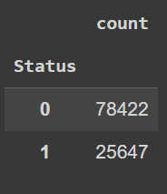
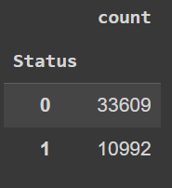
Initial Review of Loan Default dataset
Supervised binary classification problem.
(Total)
(Train)
(Test)

Slide 4
Preprocessing Steps Taken
Data Cleaning
Replace null values for justifiable columns (column: rate of interest, interest rate spread, upfront charges, LTV, dtir1).
Drop columns for non-useful features (column: ID, year).
Detect & remove outliers more than value 100 (column: LTV).
General detection & removal of outliers for whole dataset using Z-score method
Data Transformation
Categorical missing value imputation using most frequent observations (column: loan limit, approv in adv, loan purpose, neg ammortization, age, submission of application).
Numerical missing value imputation using k-NN imputer (column: term, property value, income).
Preparation for ML
Drop columns with high correlation (using V Cramer’s) for Categorical Features (column: co-applicant credit type, submission of application, security type).
Drop columns with high correlation for Numerical Features (column: rate of interest, upfront charges).
Combine low frequency categorical values for affected categorical columns (column: loan type, loan purpose, occupancy type, total units, age, region).
Use LabelEncoder for columns assumed to be of Ordinal Data (column: credit worthiness, total units, age).
Use One-hot Encoder for columns assumed to be of Nominal Data (column: the rest of object datatype columns)
Apply MinMaxScaler to standardize range from 0 to 1 (column: the rest of columns except those that uses LabelEncoder method)

Slide 5
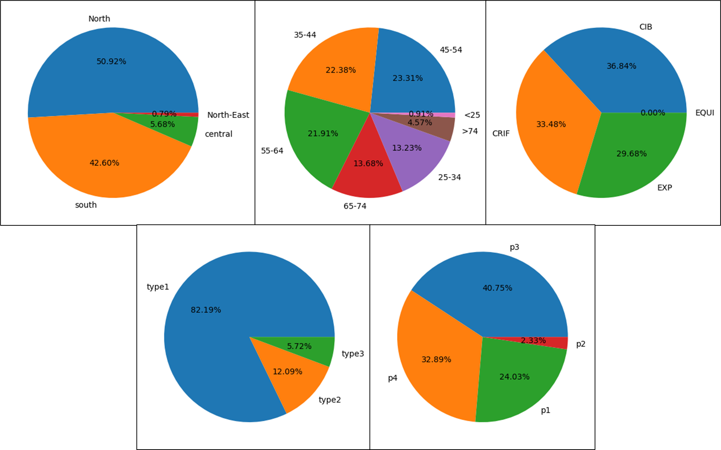
Exploratory Data Analysis (Train dataset)
Univariate Analysis
Region: Most clients resides at North & South.
Age: High percentage of clients taking loan between 35-64 years old.
Credit Type: Most client are assessed based on Credit Information Bureau, CRIF Credit Bureau or Experian standards.
Loan Type: Most client took up type1 loans.
Loan Purpose: Less client has p2 purpose while rest of the purpose are generally well distributed.

Slide 6
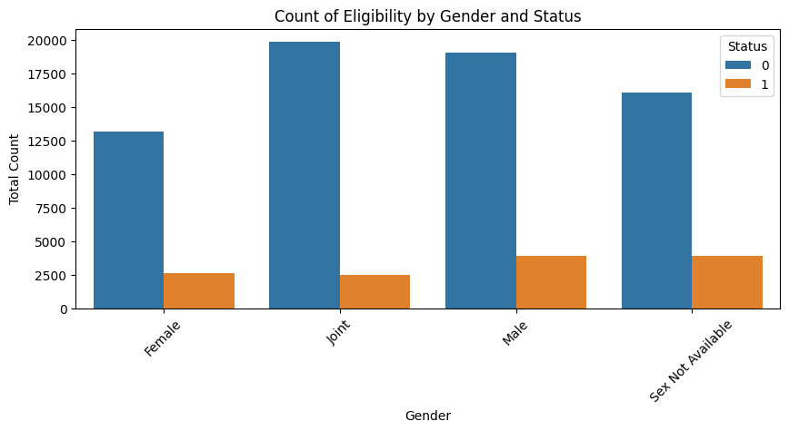
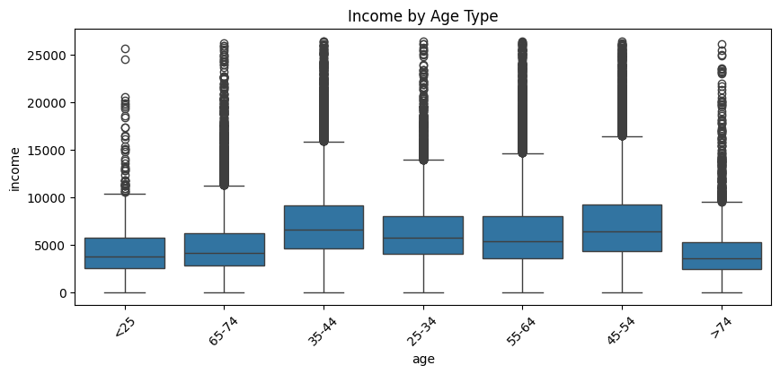
Exploratory Data Analysis (Train dataset)
Bivariate Analysis
Most transactions have not been defaulted on. But those who are male or undisclosed tend to default more.
Peak income group are usually around the age range of 35 to 54.

Slide 7
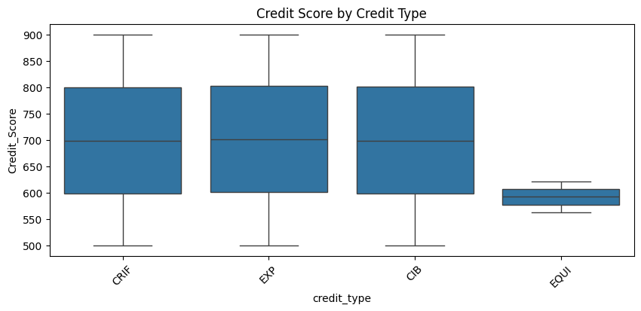
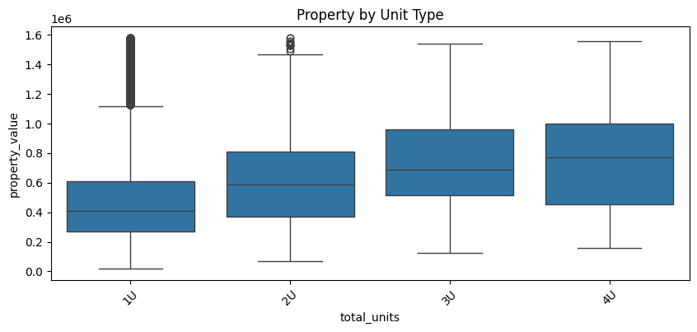
Exploratory Data Analysis (Train dataset)
Bivariate Analysis
Those with Equifax credit type have better scoring than others. While credit type from credit information bureau, CRIF credit information bureau, Experian generally has similar credit score.
The bigger the property (more units), the higher the property value.

Slide 8
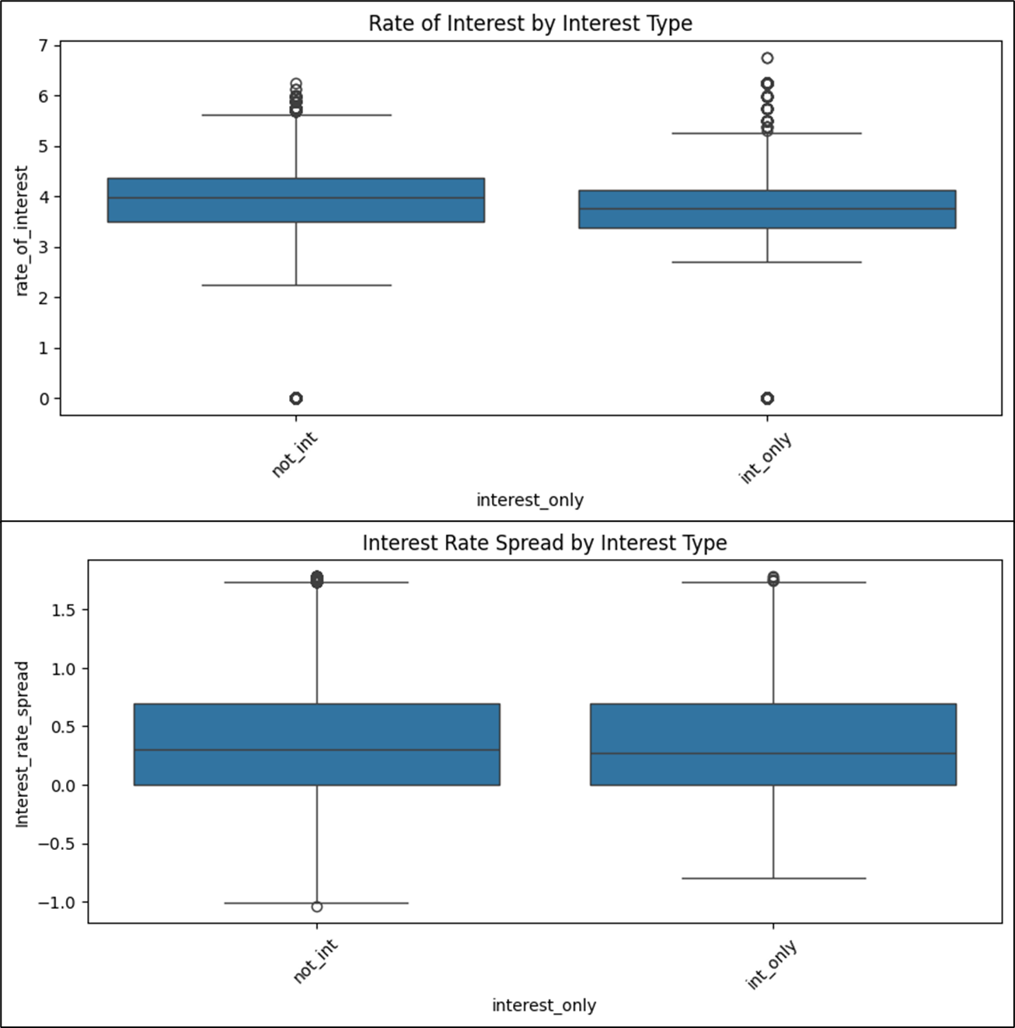
Exploratory Data Analysis (Train dataset)
Bivariate Analysis
The rate of interest gap doesn't differ much between interest types.
And the interest rate spread is generally the same.

Slide 9
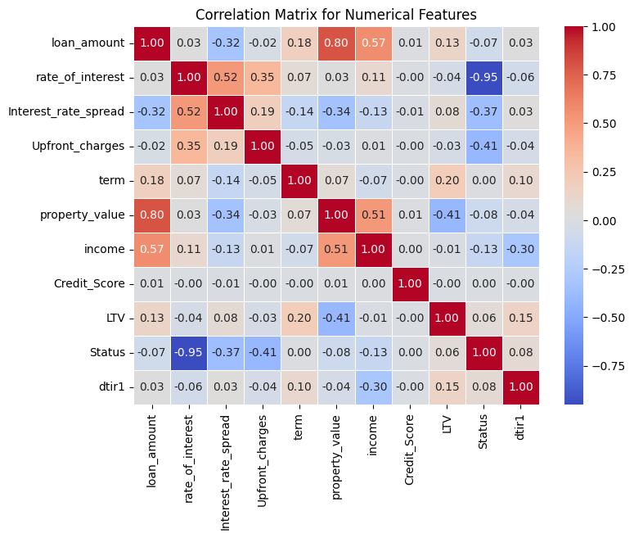
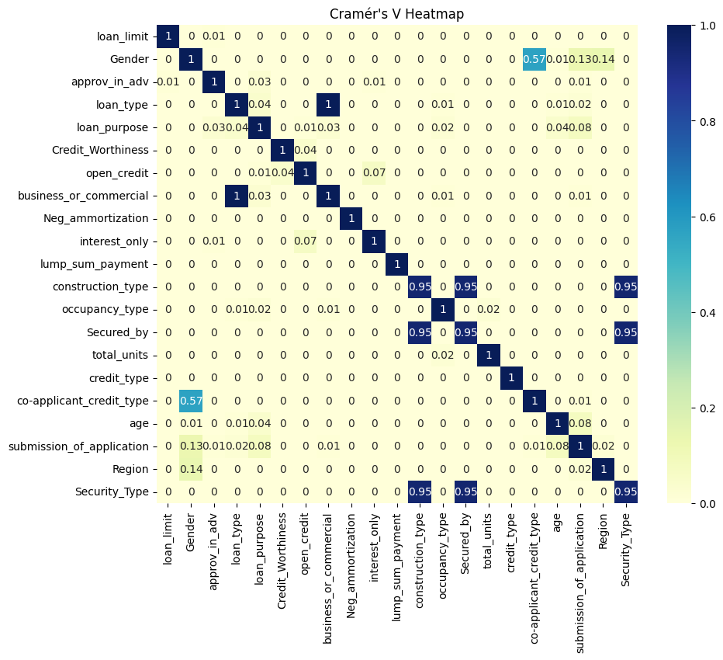
Exploratory Data Analysis (Train dataset)
Bivariate Analysis
V Cramer’s: Drop high correlated categorical columns (co-applicant_credit_type | submission_of_application | Security_Type)
Correlation Matrix: Drop high correlated numerical columns (rate_of_interest | Upfront_charges)

Slide 10
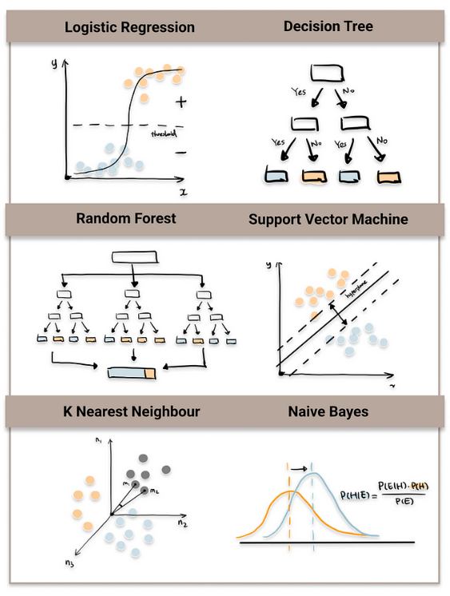
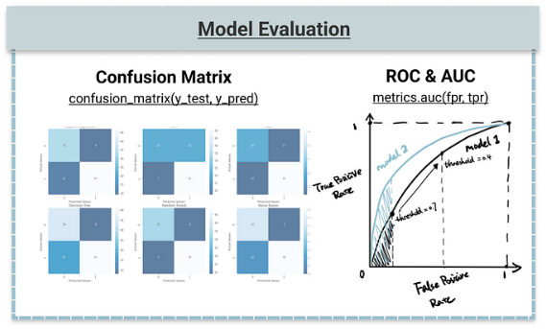
Chosen Machine Learning Algorithms
Naïve Bayes
Gaussian
Complement (Multinominal) - particularly for imbalance dataset
Random Forest
Support Vector Machine (SVM)
Kernel: Radial Basis Function (RBF)
Voting Classifier
Random Forest & SVM

Slide 11
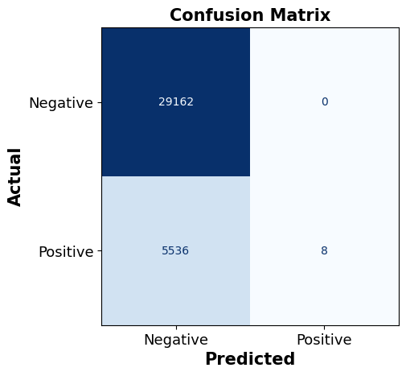
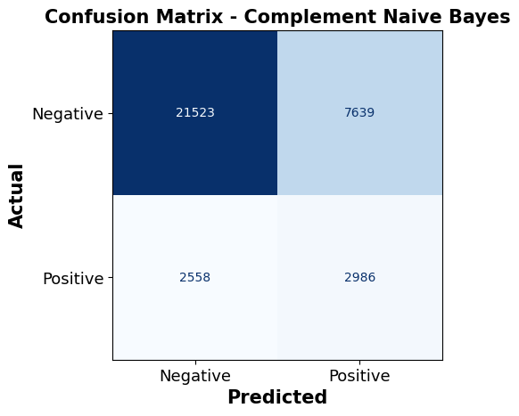
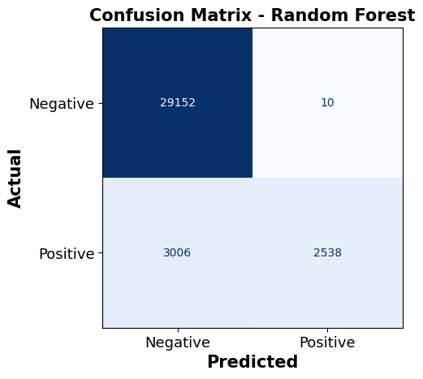
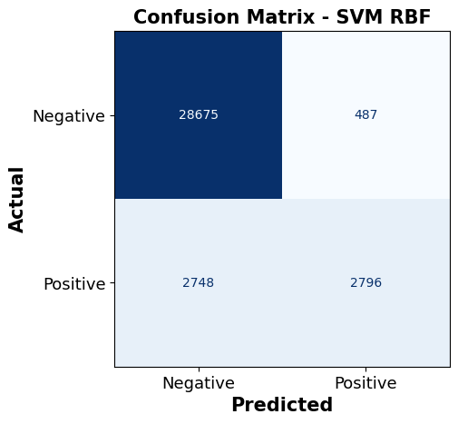
Initial Base Models Performance
S/N | Model | Accuracy (TP+TN)/ALL | Precision (TP/TP+FP) | Recall (TP/TP+TN) | F1-score
1 | Gaussian NB | 0.840489 | 1.0 | 0.001443 | 0.002882
2 | Complement NB | 0.706189 | 0.281035 | 0.5386 | 0.369349
3 | Random Forest | 0.913099 | 0.996075 | 0.457792 | 0.627286
4 | SVM (RBF kernel) | 0.906788 | 0.85166 | 0.504329 | 0.633511
Confusion Matrix – Gaussian Naïve Bayes
Gaussian NB – Cross Validation Scores: |  |  |  |  | Mean
0.8515 | 0.8545 | 0.8527 | 0.8534 | 0.8527 | 0.8530
Complement NB – Cross Validation Scores: |  |  |  |  | Mean
0.7070 | 0.7068 | 0.7101 | 0.7067 | 0.7072 | 0.7076
Random Forest – Cross Validation Scores: |  |  |  |  | Mean
0.9989 | 0.9978 | 0.9980 | 0.9984 | 0.9984 | 0.9983
SVM RBF – Cross Validation Scores: |  |  |  |  | Mean
(skip) | (skip) | (skip) | (skip) | (skip) | (skip)
TN | FP
FN | TP

Slide 12
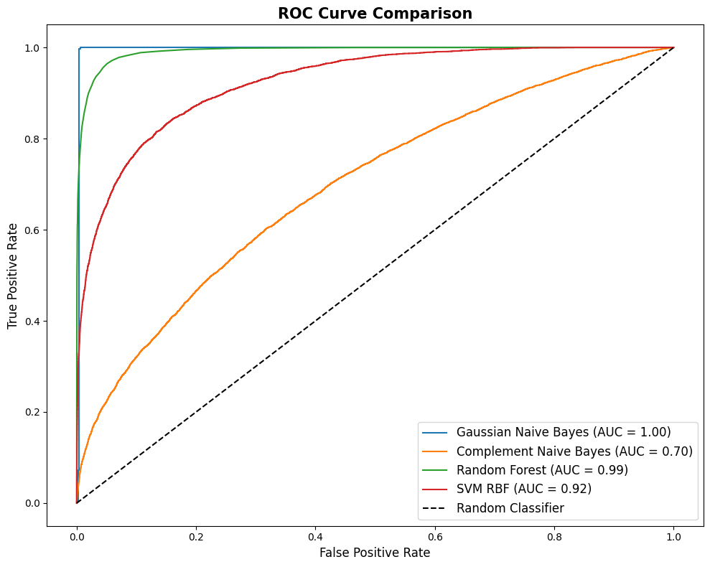
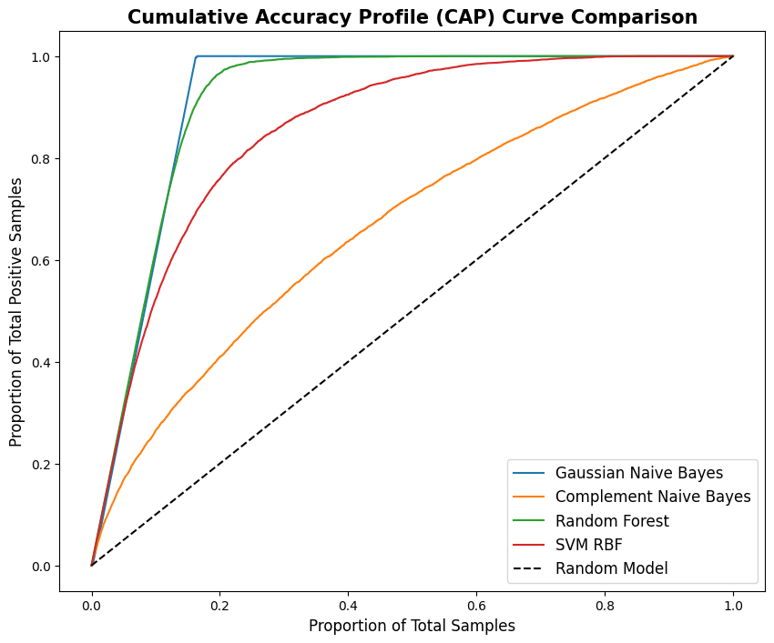
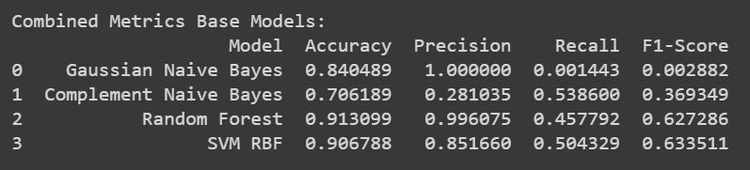
Initial Base Models Performance

Slide 13
Strategies to Overcome Misclassification
Steps for error analysis & subsequent model improvements (specifically, to increase TP & TN):
Error analysis with Confusion Matrix
Indicates no. of FPs & FNs for reduction to improve the model
Cross-Validation
Ensured model generalises well & is not overfitted to particular subset of data.
Alternative Models
Experiment with other models that might capture different relationships in the data to provide better performance.
Class Imbalance Handling
Consider oversampling minority class or undersampling majority class. (can improve recall for minority class)
Hyperparameter Tuning
Consider Grid Search/Random Search to find optimal parameters for model (improve performance for complex models)
Inspect Misclassified Cases (preliminary only)
Review those close to decision boundary. Understand why these cases were incorrectly classified for improvement insights.
Threshold Tuning (not covered)
Adjust decision threshold either to reduce FNs or FPs using ROC curve to max True Positive Rate (Recall) while keep False Positive Rate low.
Feature Importance Analysis (not covered)
Consider Feature Engineering (e.g. create new features/combine existing ones/adding intersection terms/polynomial features) or analyse feature weights.

Slide 14
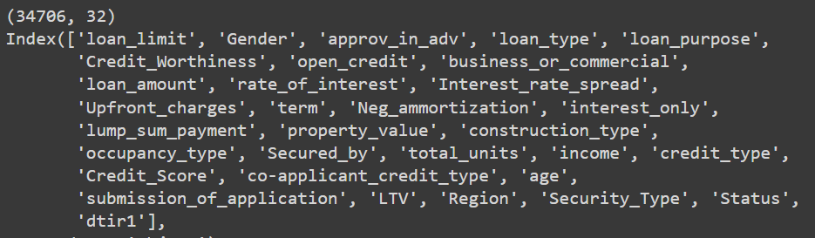
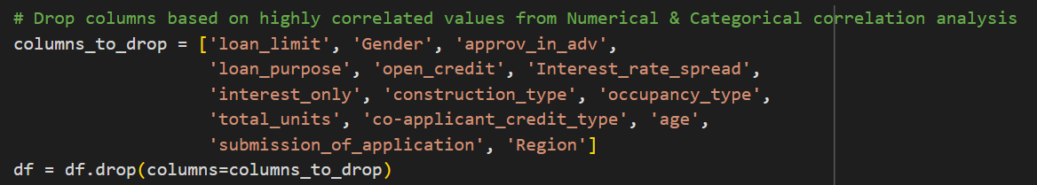
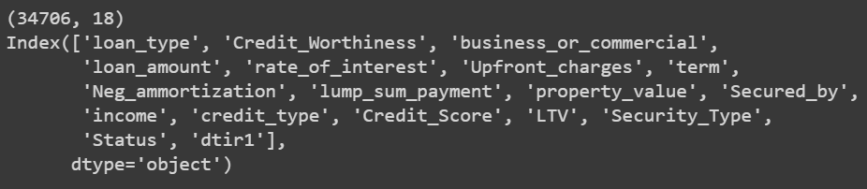
1. Feature Engineering – Feature Selection
Business Reference:
https://fastercapital.com/topics/factors-affecting-loan-default.html
https://fastercapital.com/keyword/loan-amortization.html
Note: Reduction from original dataset features with a more focused set of features. Other preprocessing steps are the same from initial.

Slide 15
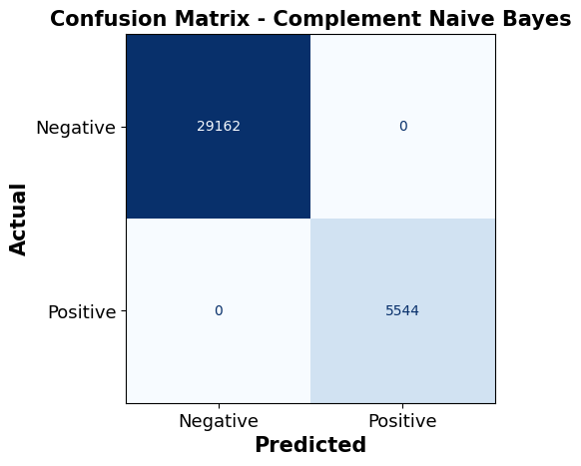
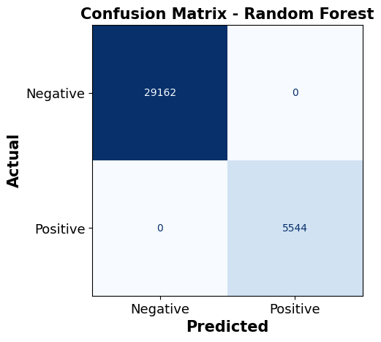
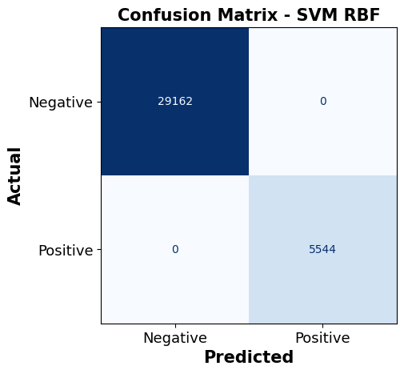
1. Feature Engineering – Feature Selection
S/N | Model | Accuracy (TP+TN)/ALL | Precision (TP/TP+FP) | Recall (TP/TP+TN) | F1-score
1 | Gaussian NB | NA | NA | NA | NA
2 | Complement NB | 1.0 | 1.0 | 1.0 | 1.0
3 | Random Forest | 1.0 | 1.0 | 1.0 | 1.0
4 | SVM (RBF kernel) | 1.0 | 1.0 | 1.0 | 1.0
Gaussian NB – Cross Validation Scores: |  |  |  |  | Mean
NA | NA | NA | NA | NA | NA
Complement NB – Cross Validation Scores: |  |  |  |  | Mean
1. | 1. | 1. | 1. | 1. | 1.0000
Random Forest – Cross Validation Scores: |  |  |  |  | Mean
1. | 1. | 1. | 1. | 1. | 1.000
SVM RBF – Cross Validation Scores: |  |  |  |  | Mean
(skip) | (skip) | (skip) | (skip) | (skip) | (skip)
TN | FP
FN | TP

Slide 16
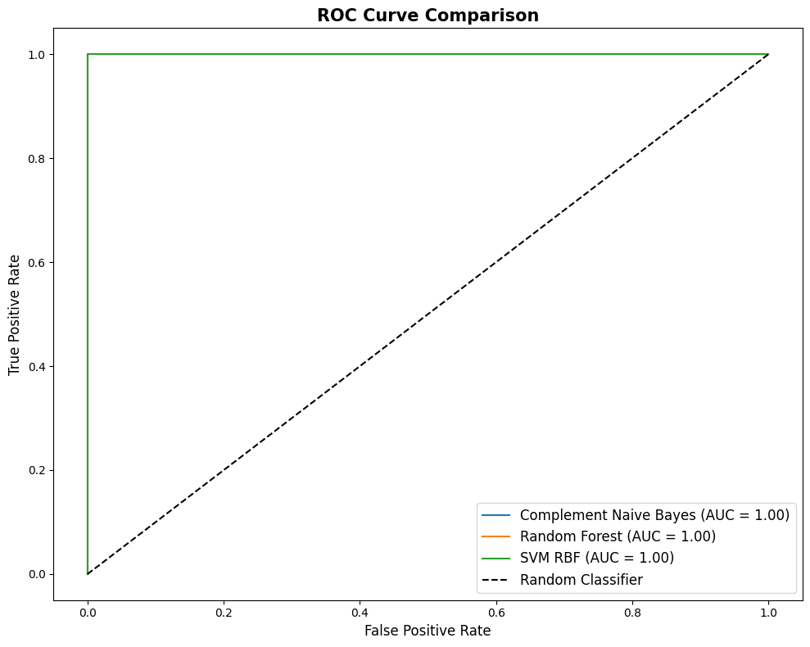
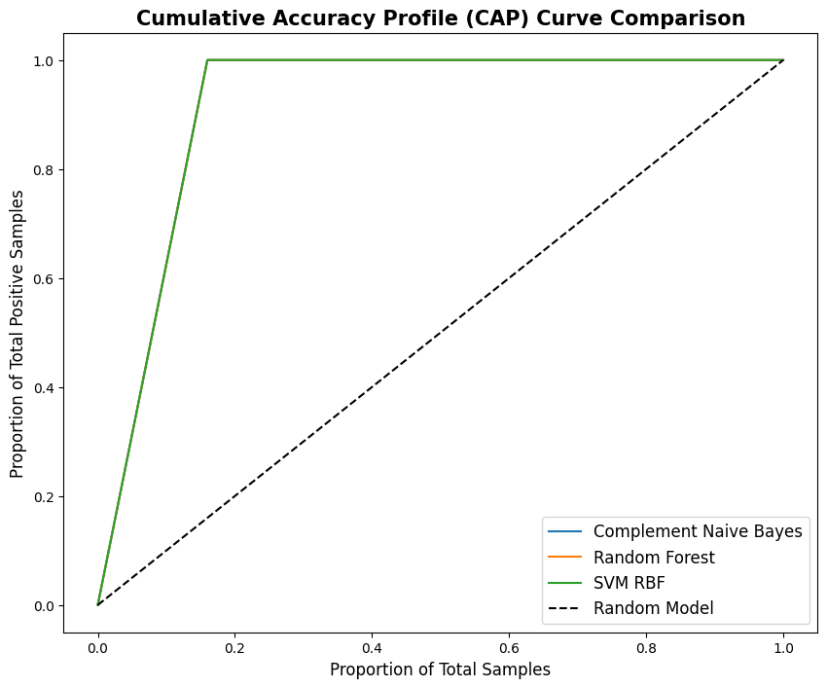
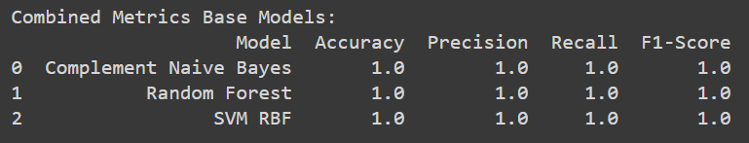
1. Feature Engineering – Feature Selection

Slide 17
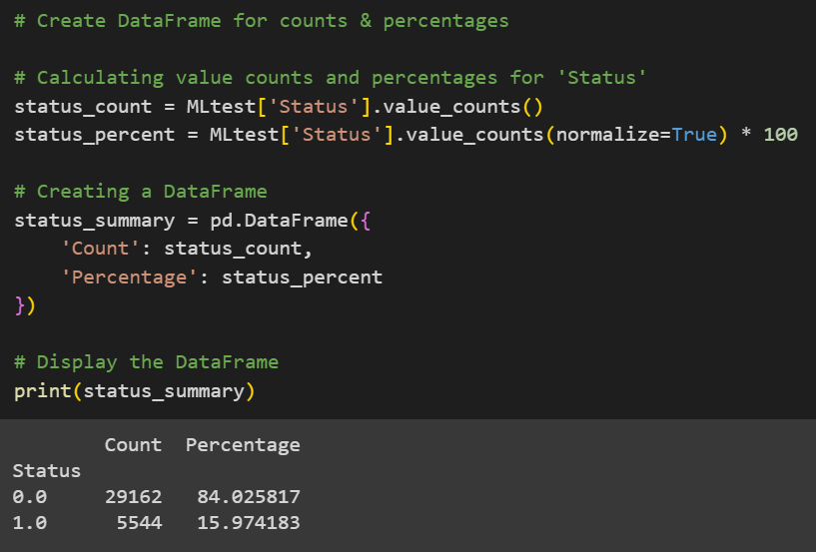

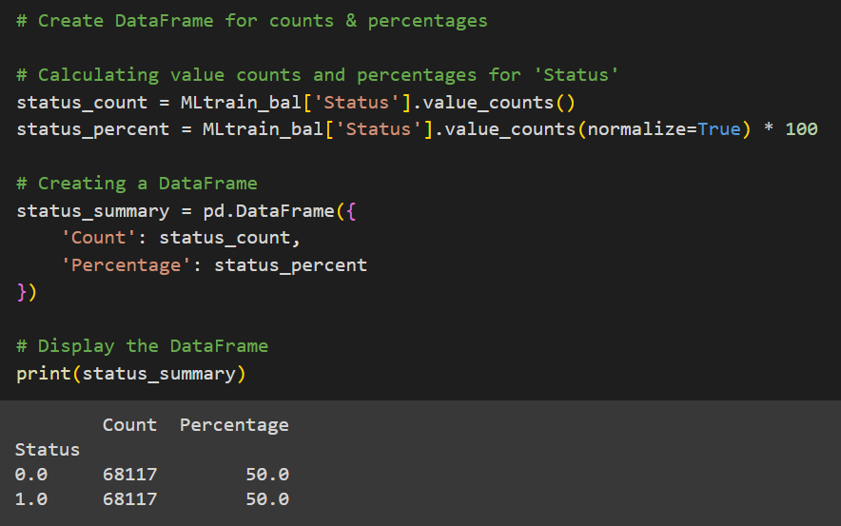
2. Oversampling – SMOTE
Note: SMOTE is only applied to Train dataset while Test dataset remained untouched.

Slide 18


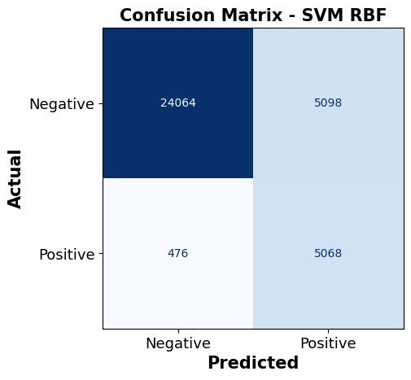
2. Oversampling – SMOTE
S/N | Model | Accuracy (TP+TN)/ALL | Precision (TP/TP+FP) | Recall (TP/TP+TN) | F1-score
1 | Gaussian NB | 0.840489 | 1.000000 | 0.001443 | 0.002882
2 | Complement NB | 0.704720 | 0.278698 | 0.534271 | 0.366312
3 | Random Forest | 0.925460 | 0.994316 | 0.536436 | 0.696895
4 | SVM (RBF kernel) | 0.839394 | 0.498524 | 0.914141 | 0.645194
5 | Voting (Hard) | 0.924393 | 0.994580 | 0.529582 | 0.691149
Confusion Matrix – Gaussian Naïve Bayes
Gaussian NB – Cross Validation Scores: |  |  |  |  | Mean
0.5986 | 0.5955 | 0.5952 | 0.5956 | 0.5857 | 0.5942
Complement NB – Cross Validation Scores: |  |  |  |  | Mean
0.6515 | 0.65730 | 0.6511 | 0.6567 | 0.6497 | 0.6533
Random Forest – Cross Validation Scores: |  |  |  |  | Mean
0.9990 | 0.9983 | 0.9985 | 0.9987 | 0.9158 | 0.9821
SVM RBF – Cross Validation Scores: |  |  |  |  | Mean
(skip) | (skip) | (skip) | (skip) | (skip) | (skip)
TN | FP
FN | TP

Slide 19
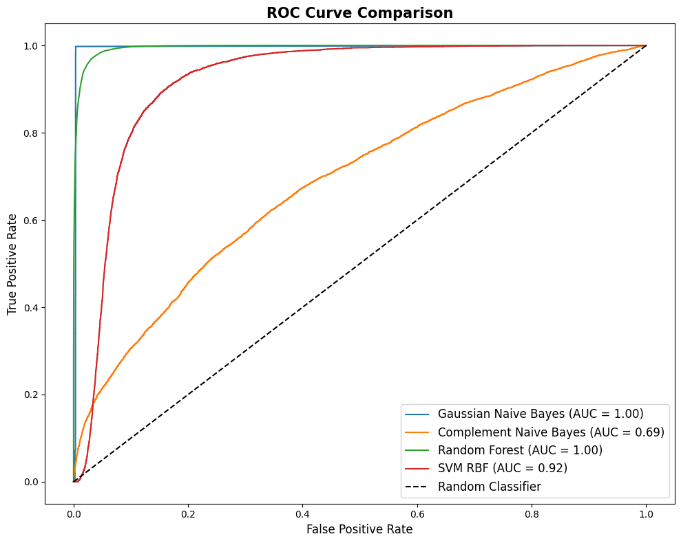
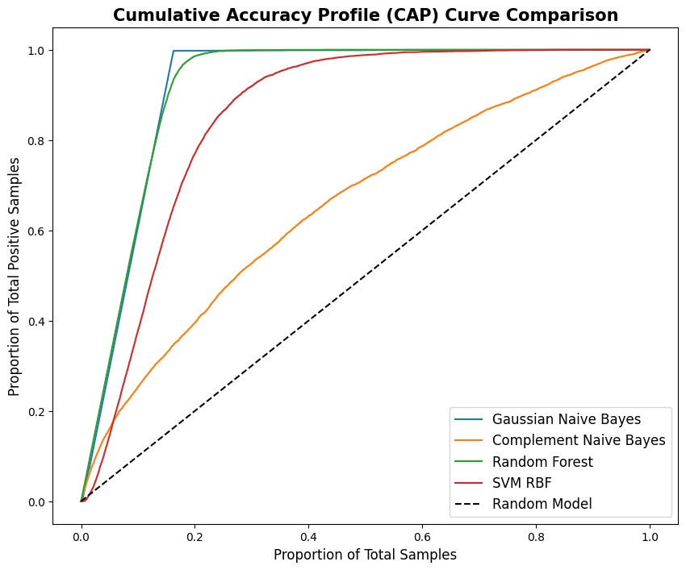
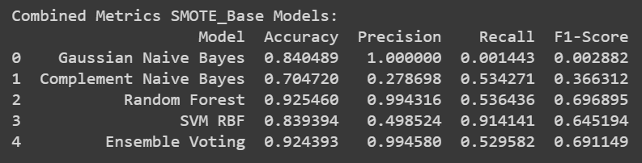
2. Oversampling – SMOTE

Slide 20
3. Hyperparameter Tuning
Complement Naïve Bayes
Technique: Grid Search
Params: alpha = [0.01, 0.1, 0.5, 1.0, 2.0, 5.0, 10.0]
Output: Fitting 5 folds for each of 7 candidates, totalling 35 fits Best parameters: {'alpha': 10.0} Best cross-validation score: 0.7095
Random Forest
Technique: Random Search
Params: n_estimators: randint(25, 50, 100) max_depth: [10, 20, 30] min_samples_split: randint(2, 5, 10) min_samples_leaf: randint(1, 2, 4) max_features: ['auto', 'sqrt', 'log2']
Output: Fitting 5 folds for each of 7 candidates, totalling 35 fits Best parameters: {'max_depth': 30, 'max_features': 'sqrt', 'min_samples_leaf': 5, 'min_samples_split': 14, 'n_estimators': 127} Best cross-validation score: 0.9990

Slide 21
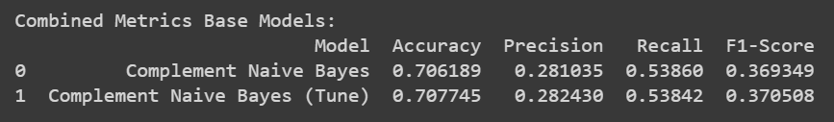
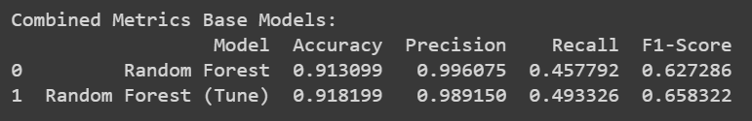
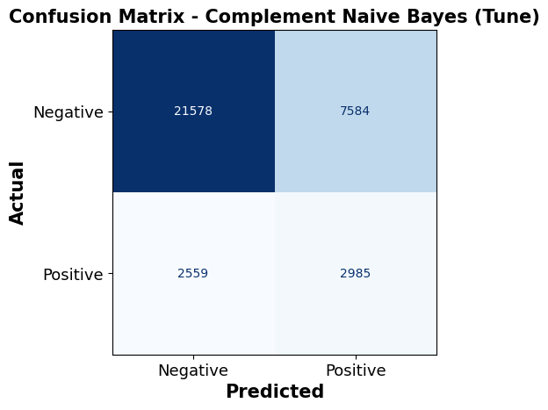
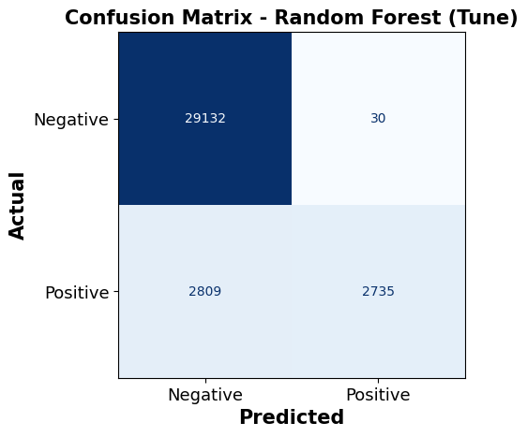
3. Hyperparameter Tuning
S/N | Model | Accuracy (TP+TN)/ALL | Precision (TP/TP+FP) | Recall (TP/TP+TN) | F1-score
1 | Gaussian NB | NA | NA | NA | NA
2 | Complement NB | 0.707745 | 0.28243 | 0.53842 | 0.370508
3 | Random Forest | 0.918199 | 0.98915 | 0.493326 | 0.658322
4 | SVM (RBF kernel) | (skip) | (skip) | (skip) | (skip)
Gaussian NB – Cross Validation Scores: |  |  |  |  | Best
NA | NA | NA | NA | NA | NA
Complement NB – Cross Validation Scores: |  |  |  |  | Best
(skip) | (skip) | (skip) | (skip) | (skip) | 0.7095
Random Forest – Cross Validation Scores: |  |  |  |  | Best
(skip) | (skip) | (skip) | (skip) | (skip) | 0.9990
SVM RBF – Cross Validation Scores: |  |  |  |  | Best
(skip) | (skip) | (skip) | (skip) | (skip) | (skip)
TN | FP
FN | TP

Slide 22
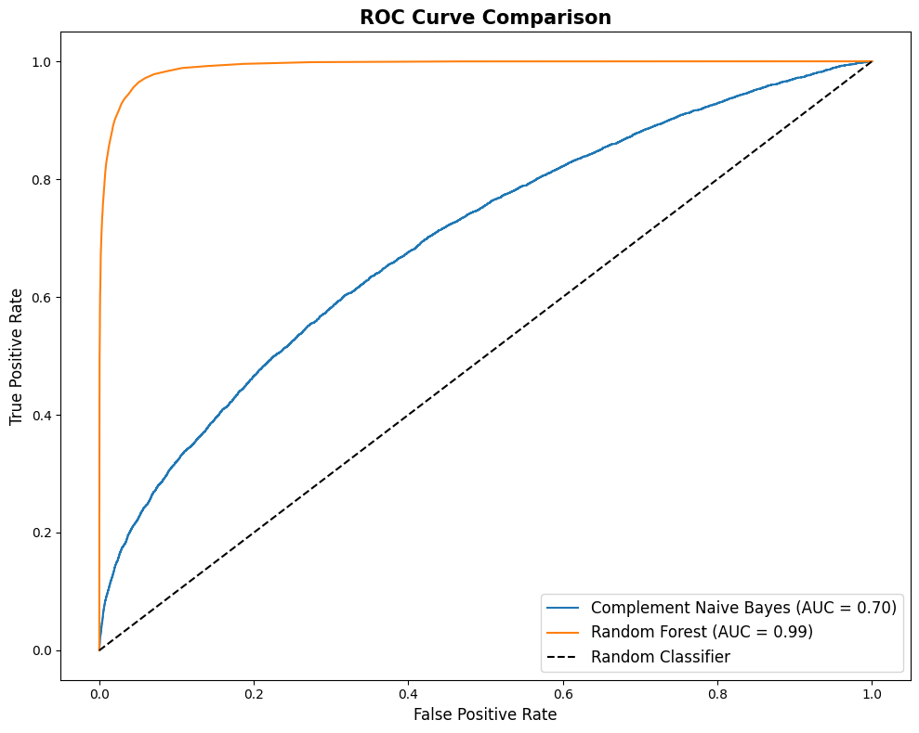
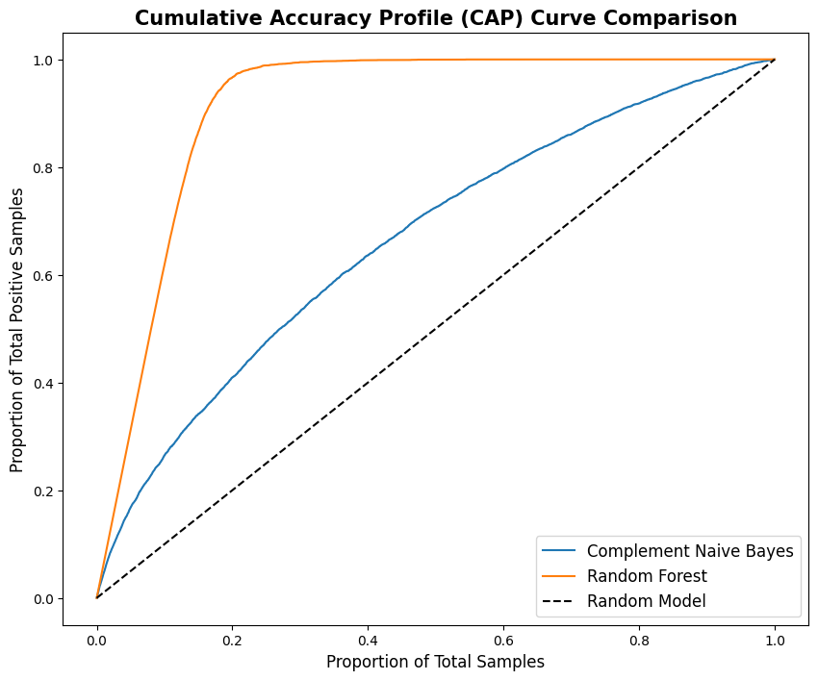
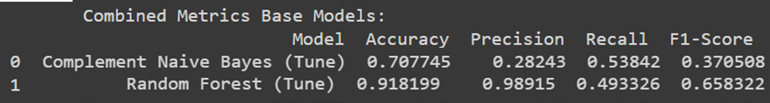
3. Hyperparameter Tuning

Slide 23



4. Error Analysis (Test vs Predicted)
Complement Naïve Bayes
Random Forest
SVM (Kernel: RBF)
Random Forest
Potential to use interest_rate_spread to create new feature based on range (green line) to separate between default & non-default.
Complement Naïve Bayes, SVM (Kernel: RBF)
Current features are difficult to find segregation. Have to explore create new features with e.g. polynomial degree.

Slide 24



4. Error Analysis (Test vs Predicted)
Complement Naïve Bayes
Random Forest
SVM (Kernel: RBF)
Complement Naïve Bayes
Actual non-default (0) was highly predicted wrongly. About 80% of misclassification.
Random Forest
Actual default (1) was highly predicted wrongly. Majority of misclassification.
SVM (Kernel: RBF)
Actual default (1) was highly predicted wrongly. About 83% of misclassification.

